Slide 1
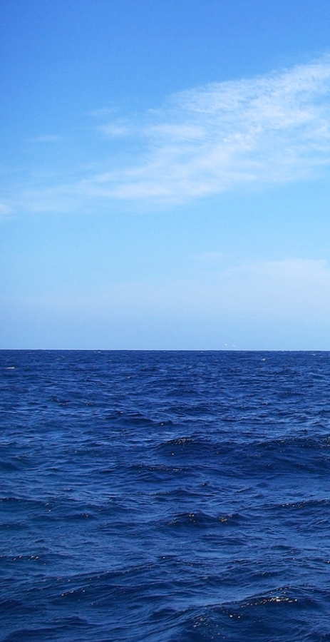
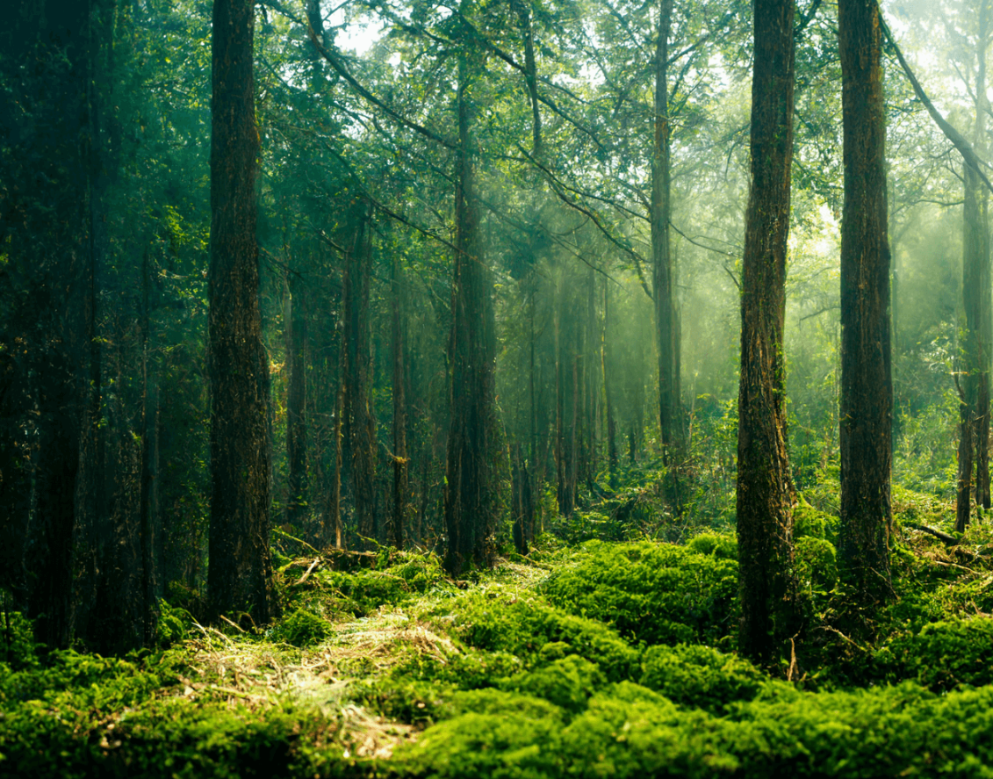
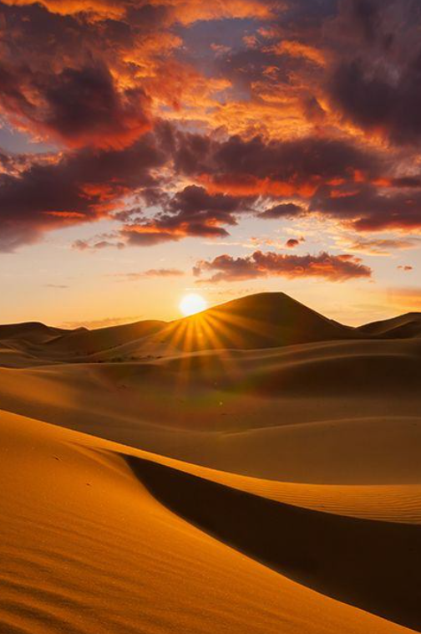
Biomes

Slide 2
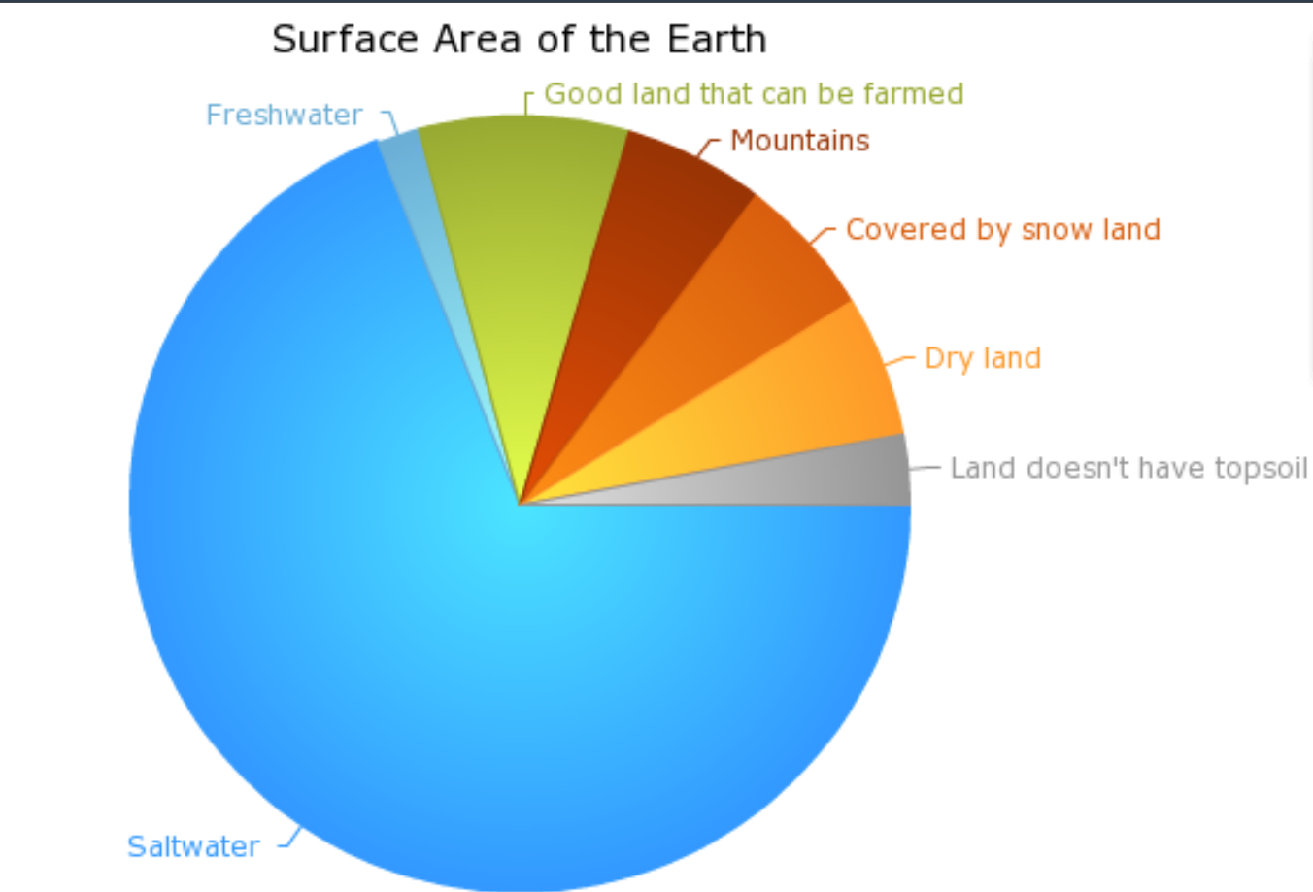

Slide 3
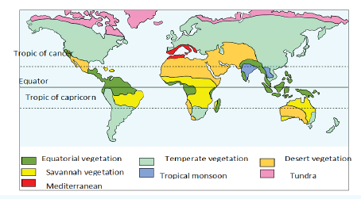


Tropical Vegetation
Temperate Vegetation
Desert Vegetation
Savannah Vegetation
Tropical Monsoon
Mediterranean Vegetation

Slide 4
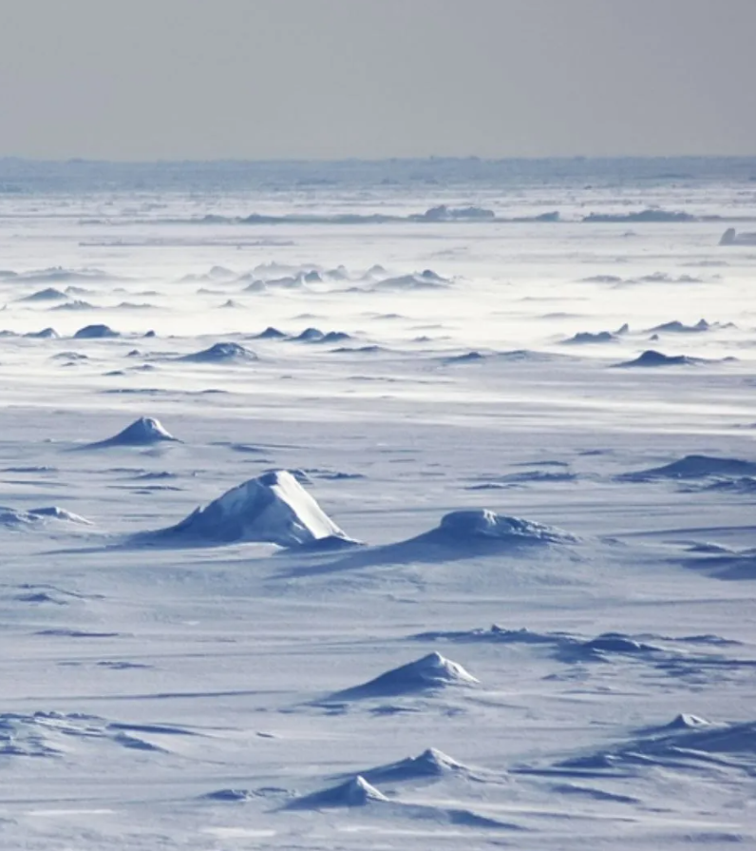
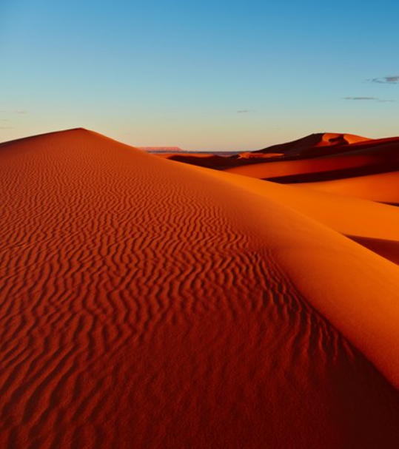

Slide 5
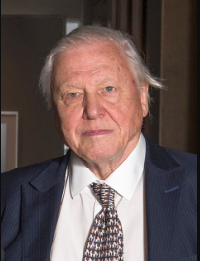
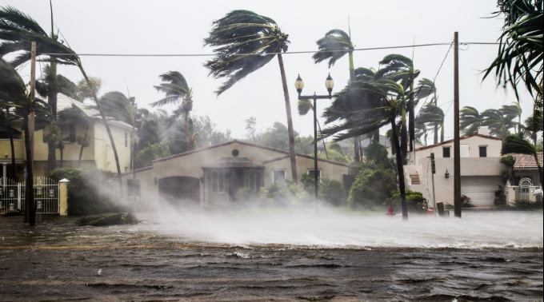
“Never before have we had such an awareness of what we are doing to the planet, and never before have we had the power to do something about that.
The future of humanity and indeed, all life on earth, now depends on us."
– David Attenborough

